Slide 1

„E!DI“ – EUREKA Danube Initiative
Common Call for Cross-border Co-operative Projects in the Danube Region 2015
First Name Surname
Organisation Name
Event Title
Event Date, Event City, Event Country

Slide 2

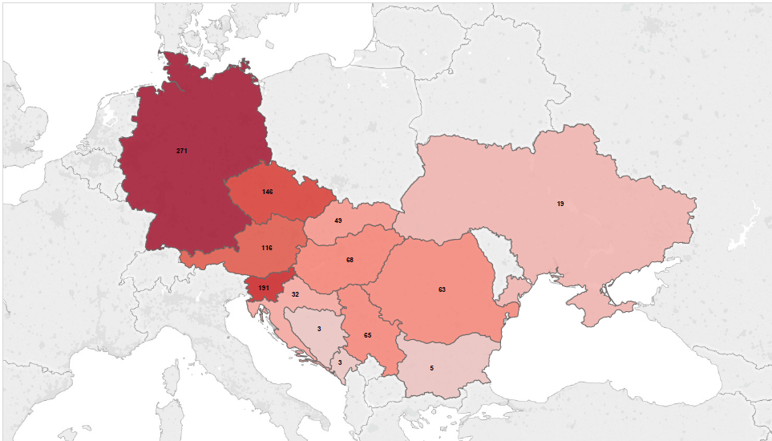
„E!DI“ Multilateral Call 2015
EUREKA Countries in the Danube Region
Austria
Bosnia and
Hercegovina
Bulgaria
Croatia
Czech Republic
Germany
Hungary
Montenegro
Romania
Serbia
Slovak Republic
Slovenia
Ukraine
Courtesy: EUREKA secretariat
(the colour code represents the number of Danube project participations in the past)
The vast majority of Danube Region countries are members of EUREKA

Slide 3
„E!DI“ Multilateral Call 2015
Motivation behind EUREKA‘s initiative
Propose EUREKA as a collaboration tool to support cross-border co-operative projects
Count on EUREKA‘s 30 years experience
Complement the efforts in the basic research sector by industrial research
Make use of a variable geometry within the EUREKA network to launch a multilateral call

Slide 4
„E!DI“ Multilateral Call 2015
Call Details
Central website
http://www.eurekanetwork.org/danube-region-call-for-projects
Call information
→ Download
Key dates
  Call opening : March 9, 2015
  Deadline project outlines: April 30, 2015
  Submission deadline: June 17, 2015
  Labeling of successful Applications: October 2015 / January 2016
Project application form
→ Download
Contact
eureka_danube@eurekanetwork.org

Slide 5
„E!DI“ Multilateral Call 2015
General Project Properties
General Project Criteria
Type of projects | Research and Development
Project Content/Goal | New innovative product, process or service
Thematic Restrictions | None (“Bottom-up”) but only civilian purpose
Type of Applicants | SMEs (for other entities check country specific rules)
Minimum Number of Partners | 2 independent enterprises
Minimum Number of Countries | 2 Danube Region countries
Maximum budget share of a single entity | 75%
Project Duration (recommended) | From 12 to 36 months
Project Funding | By the National Funding Bodies → check the country specific information

Slide 6
„E!DI“ Multilateral Call 2015
Participating Countries
Participating Countries („E!DI-countries“)
Austria (AT)
Bosnia and Hercegovina (BA) [budget under reserve]
Bulgaria (BG) [waiting for final budget confirmation]
Croatia (HR)
Czech Republic (CZ)
Germany (DE)
Hungary (HU)
Montenegro (ME)
Romania (RO)
Serbia (RS)
Slovak Republic (SK)
Country specific funding information available from website
http://www.eurekanetwork.org/danube-region-call-for-projects

Slide 7
„E!DI“ Multilateral Call 2015
Procedure
The project outline should provide information to the national offices to check basic issues like eligibility of the proprosal and the project partners.
Participation the project outline phase is not compulsory but highly recommended.
The check and the evaluation of applications are organised by the EUREKA national offices and/or the national funding bodies.
If all involved countries have evaluated positively, the project shall be endorsed for the EUREKA label
(EUREKA High Level Group).

Slide 8
„E!DI“ Multilateral Call 2015
Additional Remarks (1)
Participation of other countries
At least two E!DI-countries are needed within the frame of this call.
Further participants from other EUREKA or third countries may be project partners - provided they have secured financing of their project parts.
In the case of unavailability of public funding, participants may self fund their project part

Slide 9
„E!DI“ Multilateral Call 2015
Additional Remarks (2)
The effective start date for successful applications depends on the countries and funding bodies involved.
The national offices (see contact details in the country specific pages) are the contact points for any questions, advisory service and other call related issues.

Slide 10

Contact
Dr. Olaf HARTMANN
(Austrian EUREKA NPC)
Austrian EUREKA Office
FFG - Austrian Research and Promotion Agency
Vienna, Austria
Phone: +43 (0)57755 - 4902
olaf.hartmann@ffg.at
https://www.ffg.at/eureka
Dipl.-Phys. Ralf KÖNIG
Staff Position International Cooperation
(Danube-INCO.Net Project Task Leader)
FFG - Austrian Research and Promotion Agency
Vienna, Austria
Phone: +43 (0)57755 - 4601
ralf.koenig@ffg.at
www.ffg.at

Slide 11


