Slide 1

TRANSATLANTIC PERSPECTIVES ON SOCIAL INNOVATION
German House – Consulate General of Germany
New York City, October 6, 2015
Social Innovation:
Emergence, particular features and varied approaches
Josef Hochgerner
Zentrum für Soziale Innovation, Vienna

Slide 2


Overview
The emergence of the conceptual notion of social innovation and its recent international spread
Significant features of social innovations and the 4-i process: From idea to impact – illustrated by examples
Some thoughts about approaches to social innovation in Europe and North America

Slide 3

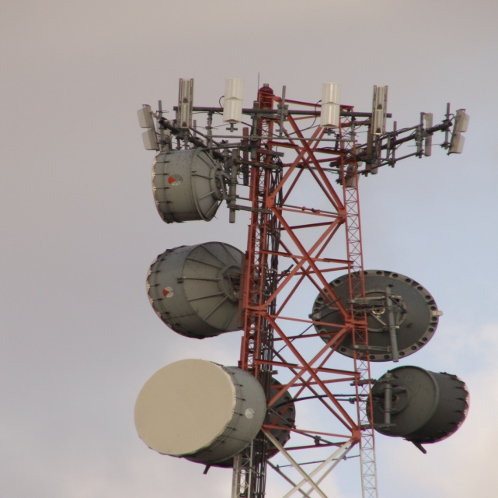

Social change, development, crisis and ‚Grand Challenges‘:
Resources and solutions
WHY SOCIAL INNOVATION ?
Evolution
of Brains
Innovative
Technologies
Social Innovation is Social Action !
Collaborative intelligence & intelligent collaboration
>> Cultural Evolution

Slide 4
The emergence of S.I. as a scientific concept and policy issue in RTDI
Networks, Research & Study Private/Pub- growing community training programs lic funds | Backbone development
„Indirect“: Project 2009: Obama EU funding: by project & Barroso FP7, H2020 | Support (finan-cial & political)
Inst. f. Social CRISES ZSI CSI & many Inventions (1985) (1988) (1990) (2000 ff.) | Organizations dedicated to SI
Joseph Schumpeter (1912) 12 books Research, Horace Kallen (1932) 1944-94 theories | Conceptualiza-tion in Sc.&Publ.
Symbols Attic democracy … Compuls. schooling Trade Unions Language Objectivation Politic. parties Chambers of .. Hierarchy [Math., Accounting ] Taylorism Drivers licence | Practices concerning the fabric of society
Building structures for soial innovations
Timeline

Slide 5

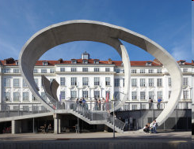
Master of Arts in Social Innovation
Danube University Krems, Austria
Department of Interactive Media and Technologies for Education – Centre of Interactive Media
Duration: 5 Semester, 120 ECTS, extra-occupational, blended learning
Launched 2013 jointly by the Danube University and ZSI
First graduates 2015 from Australia, Italy, Mexico, and Switzerland
Information:
www.donau-uni.ac.at/masi
Information: www.essi-net.eu

Slide 6
An analytical definition of Social Innovation *)
The CONCEPT OF SOCIAL INNOVATION
»Social innovations are new or improved practices
to address societal issues,
affecting parts or the whole of a society’s fabric,
and
become adopted and utilized by individuals, social groups and organizations concerned.«
*) Improved from Zentrum für Soziale Innovation, 2012:
„All innovations are socially relevant“
ZSI-Discussion Paper 13, p. 2: www.zsi.at/dp

Slide 7
HOW TO CREATE SOCIAL INNOVATION ?
The „4-i process“ of social innovation development:
  Idea >> What is the issue, objectives of change
  Intervention >> Conceptualisation, define approaches, methods
  Implementation >> Using resources, breaking deadlocks, cooperation
  Impact >> Measures of quality, range and scales, life cycle!
Ideation
Intervention
Implementation
Impact
But: It‘s usually not an ideal linear process …
Impact
Implementation
Implementation, 2nd
Intervention
Next intervention
Intervention, 3rd try
Idea
New/modified idea
Idea
… often interrupted, back to field one, iterative ...
Persistent idea
Idea
Idea

Slide 8
Analysing social innovation examples
Public sector: City of Kapfenberg (AT) – „Future for all“
Idea >> Issue: Poverty – inclusive help without stigmatisation
Intervention >> „Activity Card“ [Like Credit-Card, subsidised by the Municipality]
Implementation >> Transport, Caritas, Supermarket, Cafe, Sports ...
Impact >> Participation, elevating quality of life and cohesion
Business sector: ERSTE Bank (AT) – „2nd Savings Bank“
Idea >> Issue: Private bankruptcy – exclusion from financial services
Intervention >> Collaboration with insolvency advisers and social care NGO
Implementation >> Access to bank account, guidance by the NGO and bank volunteers
Impact >> Learning, inclusion, empowerment, scaling
Civil society: Nagykaniza (HU) – „Social housing reconstruction camp“
Idea >> Issue: Social exclusion of Roma – threat of eviction from homes
Intervention >> Negotiating rent arrears, compensation by labour contributed
Implementation >> Contracts, camp, co-working among students, roma, professionals
Impact >> Better houses, cost/energy reduction, empowerment, replication

Slide 9
Some thoughts about approaches to social innovation in Europe and North America
Framing of mind-sets:
Towards ensuring existing social
systems and amend welfare
Policy mix connects the
public, business and civil
society sectors: Tripartite
arrangements (where still
existent – middle/north EU)
Results in a more complimentary
approach to social innovations
Framing of mind-sets:
Business driven, entrepre- neurial spirit, DIY individualism
Dominance of the business sector creates need for a multitude of civil society initiatives: ‚Lean Government – Big Society‘
Leads to a more compensatory approach to social innovations
Growing cleavages: regions, social ‚classes‘, globalization winners & loosers, neoliberalism, austerity

Slide 10
Thank you for your attention ☺
Prof. Dr. Josef Hochgerner
Centre for Social Innovation
Linke Wienzeile 246
A - 1150 Vienna
Tel. ++43.1.4950442
Fax. ++43.1.4950442-40
email: hochgerner@zsi.at
http://www.zsi.at

